Slide 1


Cannabis ‘makes the grade’
Exploring cannabis content in accredited AOD training
Michael White¹ and Etty Matalon²
National Centre for Education and Training on Addiction¹ and
National Cannabis Prevention and Information Centre²

Slide 2
Forum Outline
Introductions
Cannabis - the essentials
Its only boring if… engaging students
Making it work - developing a curriculum framework
Hitting the target – different student sub-groups
Contextualising training for specific groups
Incorporating new evidence
“Cannabis competency”
Assessing cannabis competency
Assessment and RPL strategies
Moderation and continuous improvement
Review, questions, feedback and close

Slide 3
NCETA’s Roles
Research Generation
Research synthesis
Research translation
Facilitating research-policy/
practice transition
Implementing What We
Know Works

Slide 4
NCETA’s Activities
Evidence based practice and policy
original research (quantitative and qualitative)
evaluation
secondary data analysis
systematic and descriptive reviews
research dissemination (resource production, policy advice, professional development)
Strategy development

Slide 5
NCPIC’s Key Goals
NCPIC’s key goals are:
to provide the Australian community with access to evidence-based information on cannabis and related harms
to provide community access to, and awareness of, evidence-based information to prevent uptake, and continuation, of cannabis use
to supply service providers with evidence-based interventions to respond to people experiencing cannabis-related problems

Slide 6
Icebreaker - 3 things - 1 lie
Work in pairs. Introduce yourself to each other by sharing three things about yourself. One of the things should be a lie.
A bit of detail helps. You each have 2-3 minutes for your introduction.
Introduce your partner to the whole group.
We then have to guess what things were lies.

Slide 7
Workshop purpose
To provide a forum for exploring the delivery of cannabis related content in the three core AOD units of competency (CHCAOD402, CHCAOD406, CHCAOD408).
Recent research by NCETA identified that:
  many providers do not give sufficient attention to cannabis
  some of the messages given to students (both those pre-employment and in the workforce) underplay cannabis as a drug of concern
  students are leaving training unprepared to deal with clients cannabis issues[1]

Slide 8
Why is cannabis content an issue?
In 2012 NCETA undertook research resulting in a report, ‘Trainers Talking Training: An examination of vocational education and Training for the Alcohol and other Drug sector in Australia’ [1]
This report identified, along with a number of other issues, that whilst cannabis was the most popularly used illicit drug, and after alcohol and tobacco, the most common drug of concern for clients presenting at AOD services few training providers specifically:
  focused on cannabis in training
  addressed cannabis in assessment strategies
  addressed cannabis in recognition of prior learning

Slide 9
Why cannabis ‘fails to make the grade’
(findings from Trainers Talking Training)
Whilst the majority (96%) of respondents believed that it was very important that cannabis was addressed in training, they identified a number of significant barriers:
  Limited student interest
  Myths and misperceptions held by some students, trainers and AOD workers e.g., cannabis was a ‘soft’ or ‘natural’ drug
  Community acceptance of cannabis use
  Some students and trainers personal experience of use.

Slide 10
Cannabis - the essentials

Slide 11
Pop quiz
Rank the following drugs from 1 (high) -8 (low) in relation to:
 | Prevalence of use in community | Most common PDOC | Student interest | % of course devoted to drug | students likely to have used
Cannabis
Alcohol
Tobacco
Cocaine
Heroin
Meth/Amphet
Pharma
Ecstacy
Notes:
Supplementary question
How many of your students do you think use cannabis?

Slide 12
Pop quiz
Results from 2010 National Drug Strategy Household Survey Report:
 | Prevalence of use in community | % of clients with drug as PDOC | Most common PDOC | Student interest | % of course devoted to drug | students likely to have used
Alcohol | 1 (80.5%) | 45.6 | 1 | ? | ? | ?
Cannabis | 3 (10.3%) | 22.0 | 2 | ? | ? | ?
Meth/ Amphet | 6 (2.1%) | 11.2 | 3 | ? | ? | ?
Heroin | 8 (0.02) | 8.7 | 4 | ? | ? | ?
Pharmaceuts | 4 (4.2%) | 4.0 | 5 | ? | ? | ?
Tobacco | 2 (16.6 d/w) | 1.0 | 8* | ? | ? | ?
Ecstasy | 5 (3%) | 0.05 | 6 | ? | ? | ?
Cocaine | 7 (2.1%) | 0.03 | 7 | ? | ? | ?
Notes:
Cannabis is over 40% when included with other drugs
Nicotine is 22% when secondary drugs are considered

Slide 13
Cannabis: Properties
Active ingredient:
THC or delta­₉­tetrahydrocannabinol
Frequently, but
erroneously, classified as a narcotic, sedative or hallucinogen. Sits alone within a unique class
Rapidly absorbed and metabolised when smoked, less so when ingested
(1–3 hours for psychoactive effects)
Attaches to specific cannabinoid receptors in the brain.
  NCETA, 2004, Resource Kit for GP Trainers
Notes:
THC is only one of 60 cannabinoids present in the plant Cannabis sativa but it is the one responsible for its psychoactive effects
The metabolite 11-carboxy-THC remains at high plasma levels for some hours after absorption. This metabolite is inactive, but is what is measured in urine drug screens. Presence of this metabolite merely confirms recent use. Its presence does not indicate patterns of use, dependence or intoxication
Blood levels of THC vary and do not necessarily match the effects experienced. The presence of THC in urine does not necessarily indicate recent use
(Todd et al., 2002, p. 143)
When used orally, the onset of effects is delayed and may vary considerably from those experienced when smoked. To reduce the severity and duration of intoxication advise those who use oral forms to wait for the effects to commence (up to half an hour or more) before taking another dose
THC is not water soluble and therefore not suited for use by injection. THC is lipophilic - taken up and stored by body lipids. Slow elimination of metabolites results in detection of THC metabolites in urine for weeks or months after use
Approximate detection times for:
one-off use = 2 days
3 times per week use = 2 weeks
daily use = 2–4 weeks
heavy daily use = 4–6 weeks, for some up to 12 weeks
Usual cut-off detection point is 100 nanograms – but lower for defence personnel and prisoners.
Source: Todd, F., McLean, S., Krum, H., Martin, J., & Copeland, J. 2002, ‘Cannabis’, in Hulse, G., White, J. & Cape, G. (eds.) 2002, Management of Alcohol and Drug Problems, ch. 9, Oxford University Press, South Melbourne, pp. 141–157.

Slide 14
Cannabis Forms
Forms include:
  dried flowers/leaves/buds (marijuana/ganja)
    1–15% THC (depending on genetic and environmental factors)
  extracted dried resin, sometimes mixed with dried flowers and pressed into a cube (hashish)
    around 10%–20% THC
  extracted oil using an organic solvent (hashish oil)
    15–30% THC
Notes:
Joint – a cigarette containing cannabis or cannabis + tobacco.
Pipe – a tube with a ‘cone’/reservoir at the end. There are many different styles.
Bong – a ‘cone’ attached to a vessel containing water with a mouthpiece.
Bucket bong – similar to a bong but uses water pressure to force smoke into the lungs.
Source: Todd, F., McLean, S., Krum, H., Martin, J., & Copeland, J. 2002, ‘Cannabis’, in Hulse, G., White, J. & Cape, G. (eds.) 2002, Management of Alcohol and Drug Problems, ch. 9, Oxford University Press, South Melbourne, pp. 141–157.
Victoria Police 2002, Custodial Drug Guide: Medical Management of People in Custody with Alcohol and Drug Problems, Custodial Medicine Unit, Victoria Police, Mornington, Victoria.

Slide 15
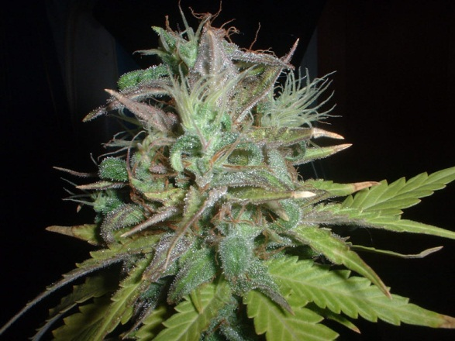
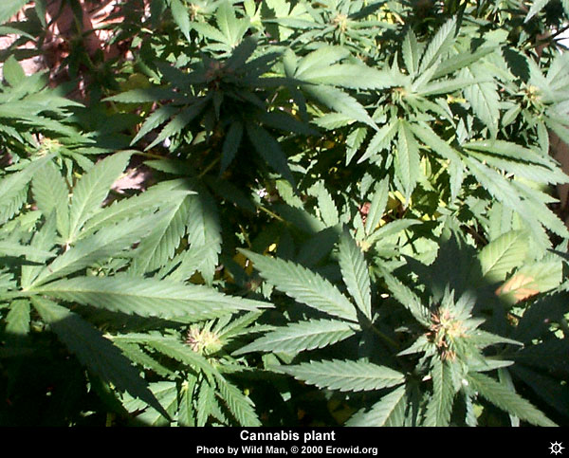
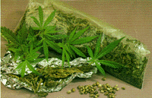
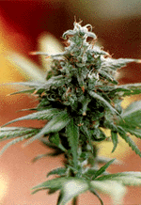
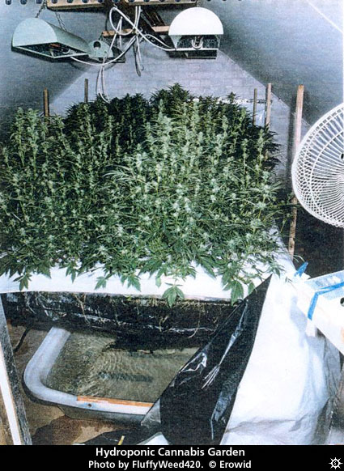
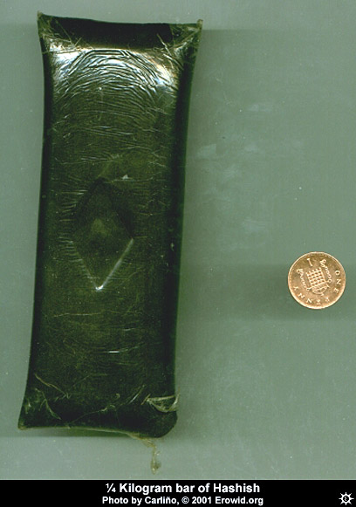
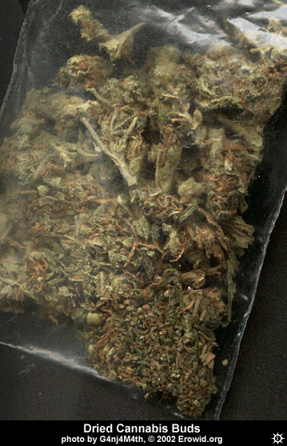
Cannabis: Forms
A
B
D
E
F
G
Notes:
E) Hydroponically Grown Cannabis
F) Hashish Bar
G) Dried Cannabis Buds (Head or Flower).
A) Cannabis Head/Flower/Bud
B) Cannabis Plant
C) Cannabis Leaves & Dried Cannabis
D) Cannabis Head/Flower/Bud
Cannabis plants are annuals, well suited to warm conditions. Hence they grow well in Australia. Male and female forms contain THC, although the flowers of the smaller female plant contain higher concentrations. Hydroponic varieties tend to produce higher concentrations of THC.
Source: http://www.erowid.org/index.html
Dried flowers/leaves/buds (marijuana/ganja): 1–15% THC (depending on genetic and environmental factors)
Extracted dried resin, sometimes mixed with dried flowers and pressed into a cube (hashish): around 10%–20% THC
Extracted oil using an organic solvent (hashish oil): 15–30% THC
Route of administration can affect dose:
smoked (joint, pipe, bong, bucket bong): 50% absorbed, peak concentration 10–30 mins, lasts 2–4 hours
ingested (cake, biscuits): 3–6% absorbed, peak concentration 2–3 hours, lasts up to 8 hours
Source: Todd, F., McLean, S., Krum, H., Martin, J., & Copeland, J. 2002, ‘Cannabis’, in Hulse, G., White, J. & Cape, G. (eds.) 2002, Management of Alcohol and Drug Problems, ch. 9, Oxford University Press, South Melbourne,
pp. 141–157.
Victoria Police 2002, Custodial Drug Guide: Medical Management of People in Custody with Alcohol and Drug Problems, Custodial Medicine Unit, Victoria Police, Mornington, Victoria.

Slide 16
Recent drug use 14+ (%) (NHDS, 2010)
Drug Behaviour | 2010 | Inc/Dec
Tobacco | 16.6 | ⬇
Alcohol | 80.5 | ⬇
Cannabis | 10.3 | ⬆
Pharmaceuticals | 4.2 | ⬆
Ecstasy | 3.0 | ⬇
Meth/Amphetamines | 2.1 | ➔
Cocaine | 2.1 | ⬆
Hallucinogens | 1.4 | ⬆
Inhalants | 0.6 | ⬆
Heroin | 0.2 | ➔
Notes:
in 2010, there was increase in the proportion of people who had used cannabis recently
in all age groups, though the only statistically significant increase was seen in those aged
50–59 years (from 3.8% in 2007 to 5.5% in 2010)
• since 1998, recent cannabis use has generally decreased in the younger age groups, but
either increased or remained stable for the older age groups (40 years or older).

Slide 17
Cannabis prevalence (NHDS, 2010/2013)
Most commonly used illicit drug in Australia
One in three (34.8%) aged 14 + reported having used in their lifetime*
Mean age of initiation – 16.7 years, increased from 16.2 years in 2010*
Over one in ten (10.3%) used in the previous 12 months*
18-19 and 20-29 yr olds most likely to have recently used (previous 12 months)#
20-29 year old males most likely to report recent use (25%) compared to 17.5% of 20-29 yr females#
increase proportion had recently used in all age groups but only statistically significant for 50–59 yr olds (3.8% in 2007 to 5.5% in 2010)#
since 1998, recent cannabis use generally decreased in younger age groups, but either increased/remained stable for older age groups (40 yrs or older)#
(2013* preliminary data has been used where available, other data is from 2010#)
Notes:
in 2010, there was increase in the proportion of people who had used cannabis recently
in all age groups, though the only statistically significant increase was seen in those aged
50–59 years (from 3.8% in 2007 to 5.5% in 2010)
• since 1998, recent cannabis use has generally decreased in the younger age groups, but
either increased or remained stable for the older age groups (40 years or older).

Slide 18
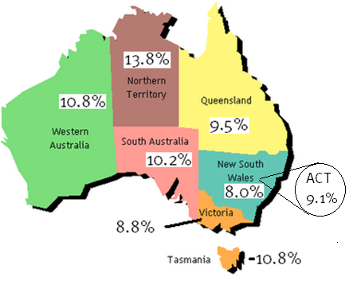
Prevalence rates around the country (NHDS, 2010)
Frequency order
1. Northern Territory
2. Tasmania
3. Western Australia
4. South Australia
5. Queensland
6. ACT
7. Victoria
8. New South Wales

Slide 19
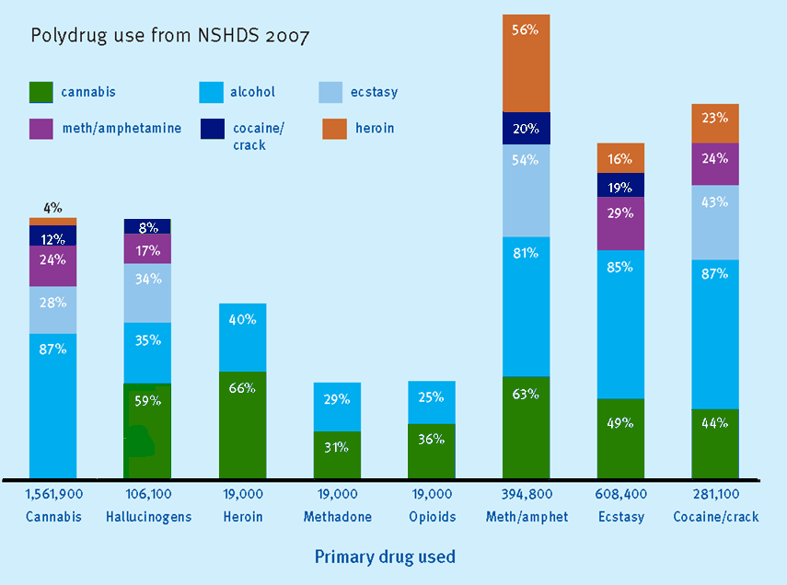
Proportion (%) of general population reporting poly-drug use
Source: NCPIC AIC Bulletin

Slide 20
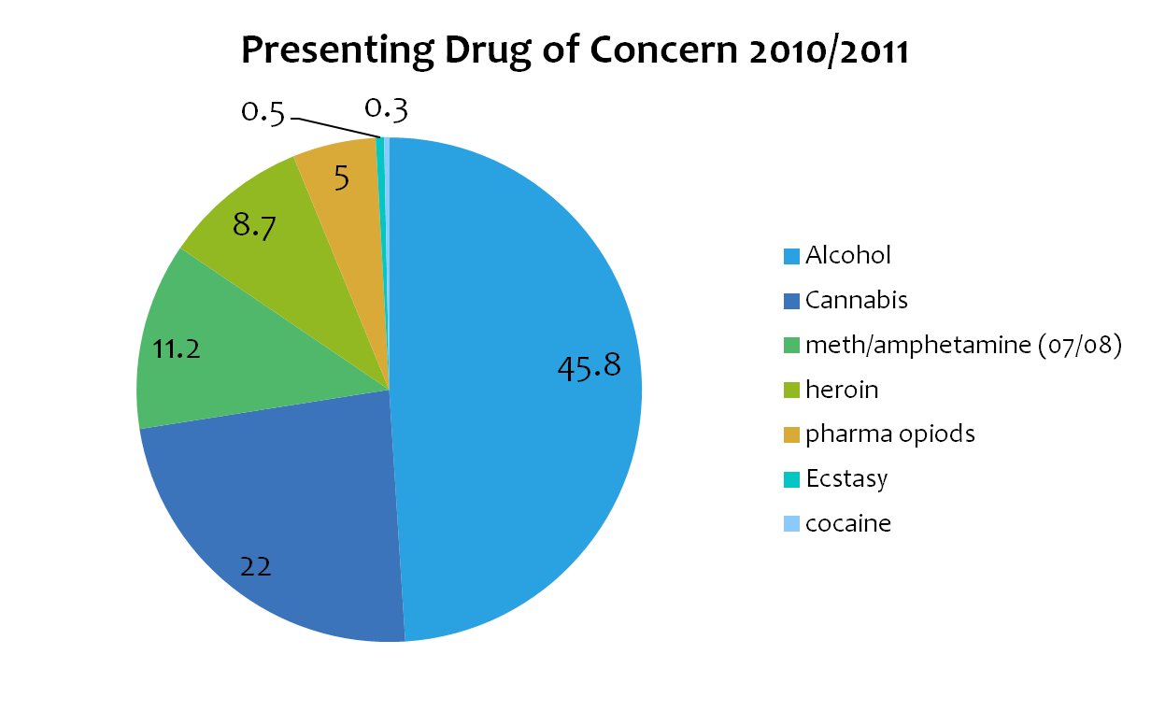
Treatment episodes (AIHW, 2012)

Slide 21
Route of administration
Can affect dose:
  smoked
      joint, pipe, bong, bucket bong
    50% absorbed, peak concentration 10–30 mins, lasts 2–4 hours.
  ingested
      cake, biscuits
    3–6% absorbed, peak concentration 2–3 hours, lasts up to 8 hours.

Slide 22
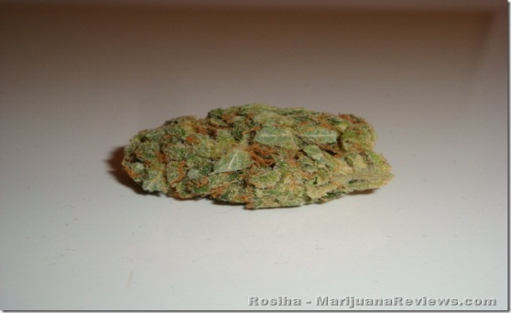
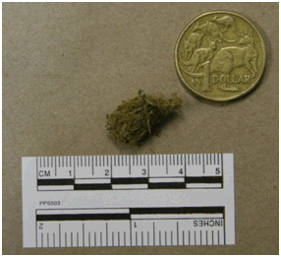
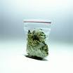
What it costs…
Average smoker
8 – 10 cones a day
56 - 70 cones per week
≃ $125 - $150
(≃ 2.25 each smoke)
1 oz = 28 grams
≃ 80 joints/280 cones
≃ $300
The more you buy the cheaper it is .......
1 gram of head/flowers
= 3 joints or 8 – 12 cones
¼ gram of cannabis head/flowers
= 3 cones
1 gram packaged
$20 – $25
Source: IDRS, 2013 participant interviews
Notes:
Note that there is considerable variability across australia in prices
Also whilst the average smoker may smoke 8-10 cones a day, many in or seeking treatment will smoke considerably more
Social /finacial impact of costs
Engagement with work?
Criminal activity to purchase, sell, possess

Slide 23
Effects of cannabis
Short-term:
feeling of well-being
talkativeness
drowsiness
loss of inhibitions
decreased nausea
increased appetite
loss of co-ordination
bloodshot eyes
dryness - eyes, mouth and throat
anxiety and paranoia
Long-term:
Limited research on long-term effects. On available evidence major probable adverse effects are:
  increased risk of respiratory diseases associated with smoking, including cancer
  decreased memory and learning abilities
  decreased motivation (study, work or concentration)
  links between cannabis use and mental health problems
  risk of dependence.

Slide 24
Short Term, High-dose Effects
Cannabis also affects:
  short term memory
  ability to learn and retain new information
  task performance
  balance, stability, mental dexterity
  the cardiovascular and respiratory systems.
Short term, high-dose use may result in:
  synesthesia
  pseudo- or true hallucinations
  delusions, feelings of depersonalisation
  paranoia, agitation, panicky feelings, ‘psychosis’.
Notes:
Synesthesia – melding of one sensory modality with another
Pseudo-hallucinations are those whereby the person is able to tell that the hallucinations are not real. A true hallucination is where the person is unable to recognise that their hallucinations are not real
Cardiovascular and respiratory system effects include tachycardia, vasodilation, hypotension, arrhythmias and bronchodilation
A short lived psychotic state associated with a high dose. It usually resolves within a week of abstinence. It may be difficult to distinguish from the precipitation of psychosis in those with a predisposition to mental illness.
Source: Todd, F., McLean, S., Krum, H., Martin, J., & Copeland, J. 2002, ‘Cannabis’, in Hulse, G., White, J. & Cape, G. (eds.) 2002, Management of Alcohol and Drug Problems, ch. 9, Oxford University Press, South Melbourne, pp. 141–157.
Victoria Police 2002, Custodial Drug Guide: Medical Management of People in Custody with Alcohol and Drug Problems, Custodial Medicine Unit, Victoria Police, Mornington, Victoria.

Slide 25
Cannabis: Acute Effects
Analgesia
Euphoria, altered concentration, relaxation, sense of calm or wellbeing, disinhibition, confusion
Increased appetite, thirst
Heightened visual, auditory and olfactory perceptions, resulting in inability to appropriately interpret surroundings
Reduced intra-ocular pressure (used for glaucoma treatment)
Nausea, headaches
With consistent use, upper respiratory tract infections
Problems associated with intoxication.
Cannabis overdose does not result in death.
Notes:
This list describes some of the possible physiological or psychological effects that may occur as a result of using cannabis. However, the relative severity of these effects or their consequences may vary enormously according to personal makeup, previous use, experiences and expectations and a range of environmental or other factors.
For clinicians, gaining an understanding of the impact, benefits and harms for the person using psychoactive drugs, rather than focusing on the drug itself, is a key step in gaining credibility and developing a relationship with patients who use psychoactive drugs.
Remember that adverse effects (considered of clinical importance from the perspective of a GP), may have little relevance for the person using the drug.

Slide 26
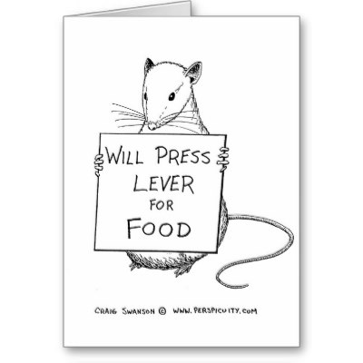
Cannabis: Heavy Use
Daily cannabis users are more likely to:
  have tried many illicit drugs
  use alcohol regularly
People with coexisting mental health
problems often report high rates of
regular cannabis use
Detox/withdrawal treatment mainly sought by men in their early 30’s:
  who are using 30–50 cones per day
  who want to regain motivation
  whose relationships are at risk with continued use.
Notes:
Swift, Hall and Teesson (2001) report that around 300,000 Australians have a ‘cannabis use disorder’
Cannabis may precipitate or exacerbate certain mental health problems (e.g. schizophrenia) in those with a predisposed vulnerability, but this link has not been proven conclusively. In many individuals, mental health problems that arise during periods of psychoactive drug use may resolve and not recur when the person has been abstinent from the drug. Ensure an accurate assessment to assist clinical management. Patients who have experienced adverse psychological or physical effects linked with their use of psychoactive drugs should be actively discouraged from reinstating use
Heavy users can exhibit lethargy, emotional apathy, mental slowing, memory impairment and poor planning ability – sometimes referred to as the ‘amotivational syndrome’. However this ‘condition’ has not been clinically proven and some argue that the effects experienced are merely the consequences of constant intoxication.
Source: Swift, W., Hall, W. & Teesson, M. 2001, ‘Cannabis Use and Dependence Among Australian Adults: Results from the National Survey of Mental Health and Wellbeing’, Addiction, vol. 96, pp. 737–748.

Slide 27

Long-term Effects
Central nervous system
Respiratory system
Cardiovascular system
Immune system
Endocrine and reproductive systems
Adverse social outcomes
Mental health problems
Cognitive impairment
Dependence
Notes:
CNS problems associated with intoxication - Heavy or daily use can affect the parts of the brain that control memory, attention, and learning.
Respiratory system
bronchitis, asthma, sore throat, chronic irritation (e.g. COAD, exacerbates asthma)
cannabis contains more tar than cigarettes. Cannabis smoke may be more highly carcinogenic than tobacco smoke. Many cannabis users are also dependent tobacco users
harms are mostly associated with the route of administration (smoking); e.g. chronic bronchitis. Smoking can result in mutagenic and carcinogenic histopathological changes of the parenchyma and epithelial cells.
Cardiovascular system
increases heart rate but decreases strength of contraction
people with cardiovascular disease may experience a decreased exercise tolerance.
Immune system
animal studies suggest that chronic cannabis use results in immunosuppression, although findings are inconclusive for humans.
Cognitive impairment
depression, anxiety, rapid mood changes reported
precipitation of schizophrenia
effects may be subtle, but include effects on memory, attention, organisation and integration of complex information. Although the current evidence suggests that these effects are not grossly debilitating, their reversibility is unknown.
Continued on page 18…

Slide 28
  Risks associated with use
Risks of acute intoxication | impaired attention, memory, and psychomotor performance while intoxicated cannabis-induced psychosis increased risk of motor-vehicle accidents
Most probable chronic effects | subtle cognitive impairment in attention, memory, and the organisation and integration of complex information (of unknown reversibility, though not likely to be grossly debilitating) increased risk of developing a dependence syndrome adverse respiratory effects, such as chronic bronchitis (greater if cannabis is used with tobacco)

Slide 29
  Risks associated with use
Possible chronic effects | increased exposure to xerostomia (dry mouth) can lead to tooth decay, gum disease, and other oral-health issues some evidence cannabis may affect human female fertility found to reduce sperm count and testosterone levels in some male animals - not established in humans children exposed to cannabis in the womb may have more difficulties with problem-solving and attention, which may continue into adulthood and reduce education potential an increased likelihood of pre-cancerous changes increased rate of lung cancer increased possibility of heart attack in people who have risk factors for heart disease (e.g. obesity and/or cigarette smoking)

Slide 30
  Risks associated with use
Probable risks amongst specific populations | associations with adolescent cannabis use: poorer school performance and outcomes lower levels of degree attainment by age 25 higher unemployment lower levels of life satisfaction leaving the family home early sexual activity and teenage pregnancy other illicit drug use and dependence in women who continue to smoke cannabis during pregnancy, increased risk of having a low birthweight baby (can lead to mortality, morbidity, and disability) exacerbation of some mental health conditions such as depression , anxiety, and schizophrenia

Slide 31
Its only boring if…
(engaging students)

Slide 32
Discussion
In small groups and working with a unit choose one element of competency and identify where cannabis could fit:
  Do you currently include content about cannabis at this point?
  What could be the consequences of increasing the focus on cannabis?
  Can cannabis content be blended with other content?

Slide 33
Finding cannabis in the competencies
ELEMENT | PERFORMANCE CRITERIA | CANNABIS RELATED CONTENT | SAMPLE ASSESSMENT ACTIVITIES/QUESTIONS
Work within the context of the AOD sector | 1.1 Reflect consideration in all work in the sector of the historical context of the sector
 | 1.2 Reflect consideration in all work of the changing social, political and economic context
 | 1.3 Reflect consideration of the interrelationship of issues affecting clients in all work in the AOD sector

Slide 34
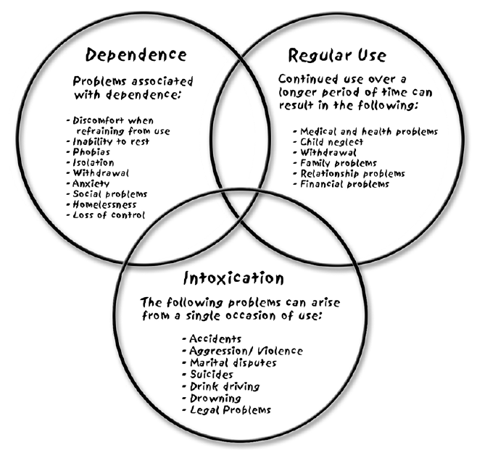
Thorley's Model of Harm
ACTIVITY
Identify harms for different drugs, include alcohol and cannabis in your response.
What are key similarities/differences in harms associated with the drugs you have chosen?
Can be used as a model for exploring the impact of drugs
http://www.youthaodtoolbox.org/thorleys-model-identifying-drug-related-harm
Notes:
Thorley's model for identifying drug-related harm
Thorley's model of problematic drug use also assists our understanding of drug-related harm. Thorley's model identifies the possible problems associated with dependence, regular use and intoxication and the overlap between these factors.
The three patterns are:
The immediate effects of use (intoxication): Often social and legal in nature including domestic and other violence, drink driving, road traffic accidents, suicides and drowning.
Regular use: Continued use over a longer period of time can have negative health consequences; create social and relationship problems; and financial problems due to continued expenditure on drugs. These problems can occur even when AOD consumption is relatively moderate.
Dependence: There is a continuum of dependence (see DSM IV & ICD 10 classifications) from mild to severe and dependence has biological, physiological and psychosocial dimensions. For young people there might also be developmental implications. Dependence is potentially harmful in all aspects of a person’s life.
It is important to remember that the majority of young people will not experience problems related to dependent use. Most of their difficulties will arise from intoxication (using at hazardous levels) or regular use. Thorley’s classification of the three aspects of drug use that cause problems – intoxication, regular use and dependent use – is useful for thinking about the kinds of interventions that are necessary to reduce the types of harms associated with each type of use.
http://www.youthaodtoolbox.org/thorleys-model-identifying-drug-related-harm

Slide 35
  Engaging student’s interest (NHDS 2010)
Students are often unaware of the importance of cannabis in clinical and community work:
Primary drug of concern in 22% of treatment episodes
Responsible for 66% of drug related arrests
Use increasing again after a number of years of decline
13% of users are daily users
72% of people who inject drugs (PWID) regularly use cannabis
46% of PWID use cannabis daily
85% of regular ecstasy users use cannabis (18% daily basis)
responsible for 5.5 ambulance call outs a day in Victoria

Slide 36
The Framework
Critical questions:
Is some of the content to basic?
Is some to difficult to deliver in the time you have available?
What other content do you have to deliver that may be lost?
Are there ways to blend cannabis and other content effectively?

Slide 37
Triaging the training
Hitting the target –
different student sub-groups

Slide 38
Discussion
What are the challenges of training different student cohorts e.g..:
  Pre-service workers
  In-service workers
  Peer support workers
  Nurses
  Students with pre-existing higher education qualifications

Slide 39
Aboriginal and Torres Strait Islander cannabis use
National Aboriginal and Torres Strait Islander Health Survey (NATSIHS) 2004/5
  19.1% lifetime use
  9.1% previous year
2004 survey rural community (Arnhem Land, NT)
  69% of the males, 26% of the females had ever used
  67% of the males, 22% of the females had used it in the last month (among 336 13-36-year-olds)
2007 National Drug Household Survey
  almost one in four Indigenous Australians used cannabis in last year
  http://ncpic.org.au/ncpic/publications/bulletins/article/bulletin-14-raising-awareness-about-cannabis-its-use-and-impact-on-health-and-wellbeing-among-indigenous-australians

Slide 40
Aboriginal and Torres Strait Islander peoples’ cannabis use
Limited available data suggests:
  Higher rates of use and dependence (especially rural communities)
  Indigenous secondary students significantly more likely to use, more susceptible to initiating use and use more frequently
  More harmful ways of using cannabis (e.g., ‘bucket bongs’)
  Indigenous communities have expressed concerns about:
    high proportion of income spent on cannabis
    community violence related to supply
    child neglect, sexual exploitation
    declining participation in community life
    reduced participation in education and training
    http://ncpic.org.au/ncpic/publications/bulletins/article/bulletin-14-raising-awareness-about-cannabis-its-use-and-impact-on-health-and-wellbeing-among-indigenous-australians

Slide 41
Aboriginal and Torres Strait Islander Students
Feeling Deadly, Working Deadly is a new NCETA resource, builds on the Indigenous Worker Wellbeing resource
It is designed to provide organisations and workers with support and information on working with Aboriginal and Torres Strait Islander colleagues
It can be used in training to explore the issues facing Indigenous AOD workers
It identifies and provides guidance on may of the issues facing Indigenous AOD workers
Cannabis is a significant problem in many Indigenous communities
Notes:
Show extract of DVD

Slide 42
Video
Watch the video ‘A day in the life…’ which is part of the NCETA Feeling Deadly, Working Deadly resource kit
Imagine Keith is a student in your course undertaking his Certificate IV in CS (AOD).
  What might be some of the issues he faces as a student based on the depiction of his life as a worker?
  What strengths might he bring to his studies?
  What might you need to adjust to make his assessemts flexible and fair?

Slide 43
Sources of Indigenous Worker Stress
Includes but is not limited to:
Workloads – numbers and complexities
Expectations on workers
Boundaries
Lack of recognition, respect and support
Working conditions
Racism and stigma
Complex personal circumstances
Loss, grief and Sorry Business
Culturally safe ways of working
Funding, job security and salaries.
Feeling Deadly, Working Deadly, NCETA, 2013

Slide 44
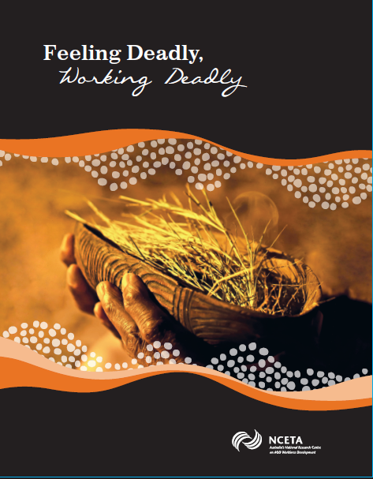
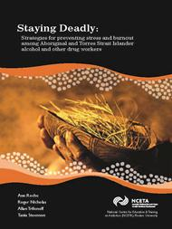
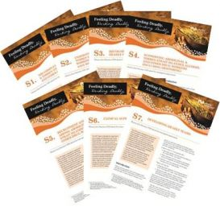
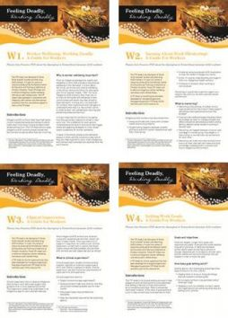
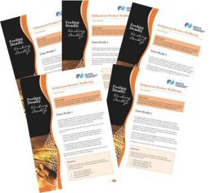
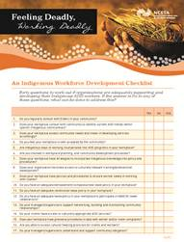
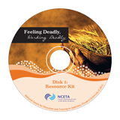
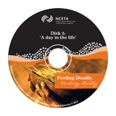
What’s in the Kit?

Slide 45

NCPIC website: Young people
The NCPIC website has also developed a young people’s section – providing information from a prevention perspective. Some of the topics covered include psychosis, dependence, sniffer dogs, cannabis and driving, joints vs bongs, etc
9 young people and their experiences with cannabis – real-life stories and a series of questions that relate

Slide 46
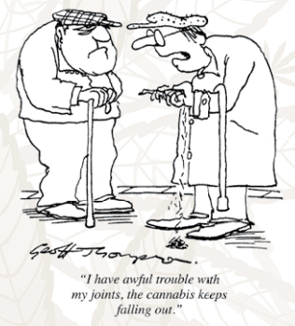
Older adults
Of illicit substances, cannabis was the most commonly used in a study of adults aged 55 and older with a mental illness. (Ryan, 2012)
“marijuana use was more common than non-medical use of prescription-type drugs among males aged 55 or older... and rates were similar with women.” (NSDUH, 2001)

Slide 47
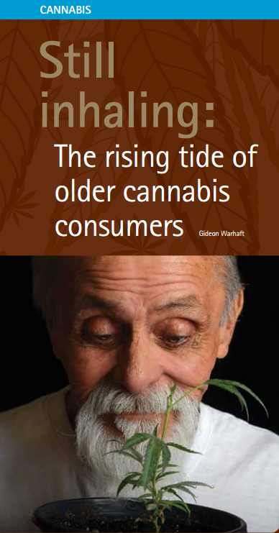
The 2010 NDSHS report showed that while there was a marginal increase in the overall population that had used cannabis recently, a more significant increase was found in those aged 50-59 years, up from 3.8 per cent in 2007 to 5.5 per cent in 2010.
Notes:
While there has been growth in treatment seeking for cannabis use in the young to young-adult population, Farrell is not inclined to think that will be refl ected in older
adults. Stephen Bright, from Australia’s only seniors-only drug treatment service, Victoria’s Older Wiser Lifestyle (OWL) program, agrees. ‘Older adults are less likely
to access traditional treatment services, which makes it diffi cult to estimate the degree to which older adults are having problems with cannabis. Prior to the OWL
program, our treatment service saw eight people aged 60 or over each year. Now we see 150. Of these, about 20 per cent admit to experiencing problems with cannabis. Almost
all of these have substance use disorders that developed before the age of 55.’ Farrell believes the rise in use will affect mainstream health services. ‘I think the big issue will be around cognitive function
and impairment that can lead to accidents and falls and that sort of thing. It’s the same issues we’re interested in around benzodiazepines and alcohol use in the older population.’
Like the older opiate-dependent population, older users of cannabis may face challenges when it comes to aged-care residential services. ‘For someone who’s been using cannabis all their life and suddenly they’re in some home where there
are rules, it might make problems,’ he cautions.

Slide 48
Incorporating new evidence
Notes:
Michael

Slide 49

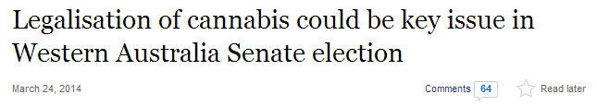

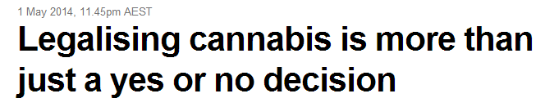
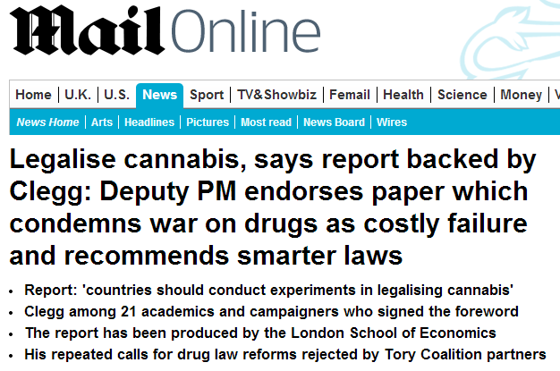
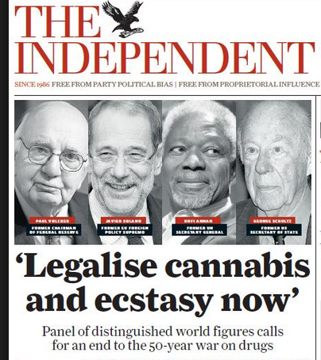
Legalisation debate

Slide 50
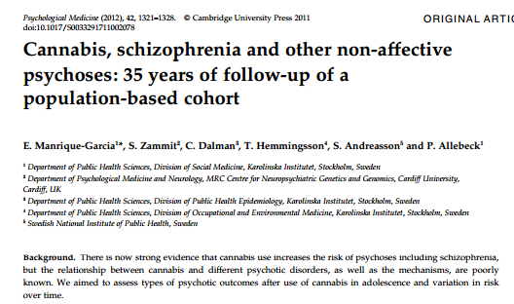
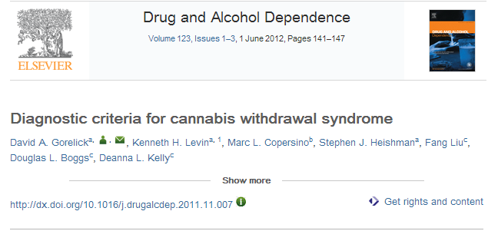
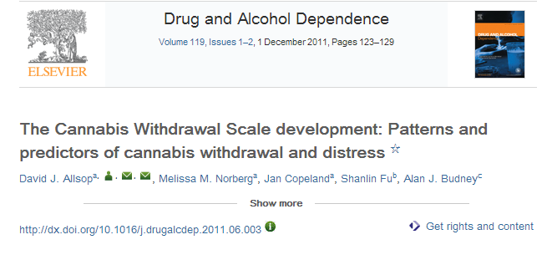
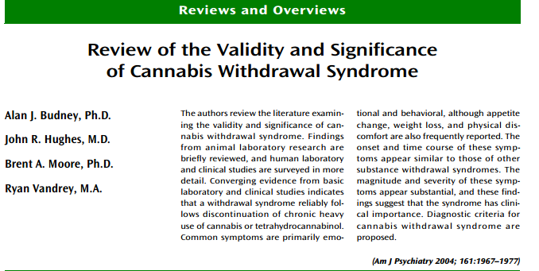
Evidence

Slide 51
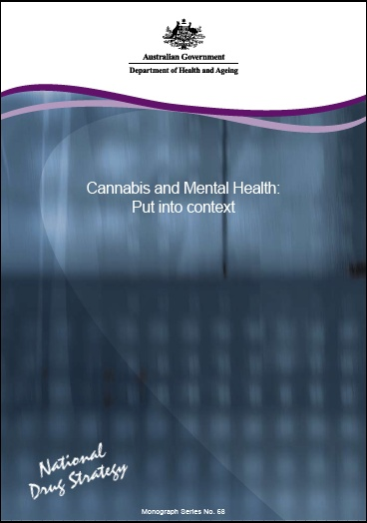
Finding evidence informed training and assessment materials
There are significant underpinning resources available:
www.nicpic.com.au
http://oyh.org.au/
http://www.turningpoint.org.au/
www.youthbeyondblue.com.au
www.sane.org.au
http://www.ysas.org.au/articles/youthaod-toolbox

Slide 52
NCPIC’s Key Activities
NCPIC’s mission is to reduce the use of cannabis in Australia by preventing uptake and providing evidence-based information and interventions.
It achieves this by offering services that include:
website providing cannabis information to the community, users, their families and workforces
a free Cannabis Information and Helpline
regular e-Zines and a Bulletin Series on the latest cannabis research by NCPIC and its partners
free training on motivational and brief interventions for cannabis-related problems
projects to inform service delivery e.g., studies on cannabis treatment seeking
development of new models of delivering interventions (e.g., via telephone, web and post)
the development of course materials for cannabis and mental health assessment and intervention at Certificate 4 level, available as course units and on-line
community activities to increase awareness of the harms associated with cannabis use e.g.:
  school poster competitions,
  short film competitions,
  Aboriginal and Torres Strait Islander music competition,
  road safety messages, and partnerships with key organisations
  dedicated website section for those working with Aboriginal and Torres Strait Islander peoples
NCPIC is a Department of Health initiative.

Slide 53
Evidence based interventions
Randomised controlled trials (RCTs) for cannabis use disorder only reported in literature in last 15 years.
Many clinicians conclude the relatively mild cannabis withdrawal syndrome indicates that dependence unlikely and treatment unnecessary
However research suggests that a substantial proportion of cannabis users develop cannabis-related problems, including abuse and dependence.
Whilst only a minority seek assistance from a health professional, demand for treatment for cannabis use disorder is increasing internationally.
http://ncpic.org.au/ncpic/publications/research-briefs/article/evidence-based-interventions-for-cannabis-use-disorder
Notes:
Evidence-based interventions for cannabis use disorder
Introduction
Despite cannabis being the most widely used illicit drug in the Western world,^{1,2} controlled trials for cannabis use disorder have been reported in the literature only in the last 15 years. Although many clinicians continue to conclude that the relatively mild withdrawal syndrome associated with cannabis indicates that dependence is unlikely and treatment is unnecessary, research suggests that a substantial proportion of cannabis users develop cannabis-related problems, including abuse and dependence.^{2,3-6} Despite these trends, only a minority seek assistance from a health professional,⁷ however, demand for treatment for cannabis use disorder is increasing internationally.⁸
Pharmacological interventions
There are no randomised control trials (RCTs) of pharmacological interventions for cannabis withdrawal or craving. The results of less methodologically rigorous studies suggest that oral delta 9-tetrahydrocannabinol (THC),^{9,10} and possibly mirtazapine¹¹ and lithium,¹² are promising for cannabis withdrawal, and that rimonobant¹³ and perhaps buspiron¹⁴ show potential in the management of cannabis craving. Buproprion,¹⁵ nefazodone,¹⁶ divalproex,^{11,17} naltrexone¹⁸ and atomoxetine¹⁹ appear less promising for cannabis withdrawal or craving. Also, early indications suggest that oral THC is ineffective in the management of cannabis craving.⁹
Psychological interventions
A series of RCTs of psychotherapeutic approaches to managing cannabis dependence have been conducted. In general, these suggest that cognitive behavioural therapy (CBT) and motivational enhancement therapy (MET) are the most effective in reducing cannabis use, dependence and related problems.²⁰⁻²² Social support psychotherapy showed equivalence with CBT in one study.²³ Although brief interventions (usually in the form of MET) appear effective, recent studies suggest that extended, combined therapies are associated with slightly better outcomes.^{21,22} In addition, recent research suggests that adding voucher-based incentives to MET and CBT improves treatment compliance and long-term outcome in both voluntary²⁴⁻²⁶ and coerced adult clients,²⁷⁻²⁹ but that voucher-based incentives alone show improvements in compliance and outcome that diminish over time.²⁵
Adolescent and psychiatric populations
Several RCTs suggest that brief interventions—which may involve the provision of information (including to parents), MET, and cognitive behavioural skills training—are effective in reducing cannabis use and dependence in adolescents.^{30,31} It also appears that extended therapies, which often incorporate significant family involvement (such as multidimensional family therapy), are effective in reducing cannabis use and dependence in adolescents, but no more so than are brief interventions.³² Contingency management also shows promise in enhancing treatment engagement in adolescents.³³
There is one RCT examining effective treatments for comorbid cannabis use and psychotic disorders, which compared ‘treatment as usual’ to ten sessions of motivational interviewing and cognitive behavioural therapy.³⁴ Clinicians’ recommendations for the management of substance use in the context of severe and persistent mental illness rests with integrated shared care or dual diagnosis services, in which the critical components are staffed interventions, assertive outreach, motivational interventions, counselling, social support interventions, a comprehensive and long-term perspective, and cultural sensitivity and competence.^{35,36}
Conclusion
Although the strongest evidence in the management of cannabis dependence exists for MET and CBT in adults and brief interventions in adolescents, further RCTs are required to clarify the effectiveness of other treatments, particularly pharmacological interventions and those designed for psychiatrically comorbid cannabis users.
References
Anthony, J., Warner, L. & Kessler, R. (1994). Comparative epidemiology of dependence on tobacco, alcohol, controlled substance and inhalants: Basic findings from the National Comorbidity Survey. Experimental and Clinical Psychopharmacology 2, 244-268.
Swift, W., Hall, W. & Teesson, M. (2001). Cannabis use and dependence among Australian adults: Results from the National Survey of Mental Health and Wellbeing. Addiction 96, 737-748.
Anthony, J.C. & Helzer, J.E. (1991). Syndromes of drug abuse and dependence. In. L.N. Robins & D.A. Regier. (Eds.). Psychiatric disorders in America: The Epidemiological Catchment Area Study, pp. 116-154. New York: The Free Press.
Bierut, L.J., Dinwiddie, S.H., Begleiter, H., Crowe, R.R., Hesselbrock, V., Nurnberger, J.I. Jr., Porjesz, B., Schuckit, M.A., & Reich, T. (1998). Familial transmission of substance dependence: Alcohol, marijuana, cocaine, and habitual smoking: A report from the Collaborative Study on the Genetics of Alcoholism. Archives of General Psychiatry 55, 982-988.
Grant, B.F. & Pickering, R. (1998). The relationship between cannabis use and DSM-IV cannabis abuse and dependence: Results from the National Longitudinal Alcohol Epidemiologic Survey. Journal of Substance Abuse 10, 255-264.
Young, S.E., Corley, R.P., Stallings, M.C., Rhee, S.H., Crowley, T.J., & Hewitt, J.K. (2002). Substance use, abuse and dependence in adolescence: Prevalence, symptom profiles and correlates. Drug and Alcohol Dependence 68, 309-322.
Copeland, J., Rees, V. & Swift, W. (1999). Health concerns and help-seeking among a sample entering treatment for cannabis dependence. Australian Family Physician 28, 540-541.
Substance Abuse and Mental Health Services Administration, Office of Applied Studies. (2003). Emergency department trends from the drug abuse warning network, final estimates 1995–2002, DAWN Series: D-24, DHHS Publication No. (SMA) 03-3780. Rockville, MD: Substance Abuse and Mental Health Services Administration, Office of Applied Studies.
Hart, C., Haney, M., Ward, A., Fischman, M.W., & Foltin, R.W. (2002). Effects of oral THC maintenance on smoked marijuana self-administration. Drug and Alcohol Dependence 67, 301-399.
Haney, M., Hart, C., Vosburg, S., Nasser, J., Bennett, A., & Zubaran, C., et al. (2004). Marijuana withdrawal in humans: Effects of oral THC or divalproex. Neuropsychopharmacology 29, 158-170.
Frewen, A., Baillie, A. & Rea, F. (2007, June). The role of mirtazapine in cannabis withdrawal. Paper contributed to the College on Problems of Drug Dependence. Quebec, Canada. Retrieved on September 8, 2008, from http://www.cpdd.vcu.edu/Pages/Meetings/Meetings_PDFs/2007programbooknew.pdf
Shu-Sen, C., Bowen, R.C., Gu, G.B., Hannesson, D.K., Yu, P.H., & Zhang, X. (2001). Prevention of cannabinoid withdrawal syndrome by lithium: Involvement of oxytocinergic neuronal activity. Journal of Neuroscience 21, 9867-9876.
Heustis, M.A., Gorelick, D.A., Heishman, S.J., Preston, K.L., Nelson, R.A., & Moolchan, E.T. (2001). Blockade effects of smoked marijuana by the CB1-selective cannabinoid receptor antagonist SR141716. Archives of General Psychiatry 58, 322-328.
McRae, A.L., Brady, K.T. & Carter, R.E. (2006). Buspirone for treatment of marijuana dependence: A pilot study. American Journal on Addictions 15, 404.
Haney, M., Ward, A.S., Comer, S.D., Hart, C.L., Foltin, R.W., & Fischman, M.W. (2001). Buproprion SR worsens mood during marijuana withdrawal in humans. Psychopharmacology 155, 171-179.
Haney, M., Hart, C., Ward, A., & Foltin, R.W. (2003). Nefazodone decreases anxiety during marijuana withdrawal in humans. Psychopharmacology 165, 157-165.
Levin, F.R., McDowell, D., Evans, S.M., Nunes, E., Akerele, E., & Donovan, S. et al. (2004). Pharmacotherapy for marijuana dependence: A double-blind, placebo-controlled pilot study of divalproex sodium. American Journal on Addictions 13, 21-32.
Haney, M., Bisaga, A. & Foltin, R.W. (2003). Interaction between naltrexone and oral THC in heavy marijuana smokers. Psychopharmacology 166, 77-85.
Tirado, C.F., Goldman, M., Kampman, K.M., & O’Brien, C.P. (2007, June). Atomoxetine for treatment of marijuana dependence: A report on the efficacy and high incidence of gastrointestinal adverse events in a pilot study. Paper contributed to the College on Problems of Drug Dependence. Quebec, Canada. Retrieved on September 8, 2008, from http://www.cpdd.vcu.edu/Pages/Meetings/Meetings_PDFs/2007programbooknew.pdf
Stephens, R., Roffman, R. & Curtin, L. (2000). Comparison of extended versus brief treatments for marijuana use. Journal of Consulting and Clinical Psychology 68, 898-908.
Copeland, J., Swift, W., Roffman, R., & Stephens, R. (2001). A randomised controlled trial of brief interventions for cannabis use disorder. Journal of Substance Abuse Treatment 21, 55-64.
Babor, T., Carroll, K., Christiansen, K., Donaldson, J., Herrell, J., & Kadden, R. et al. (2004). Brief treatments for cannabis dependence: Findings from a randomised multi-site trial. Journal of Consulting and Clinical Psychology 72, 455-466.
Stephens, R., Roffman, R. & Simpson, E. (1994). Treating adult marijuana dependence: A test of the relapse prevention model. Journal of Consulting and Clinical Psychology 62, 92-99.
Budney, A., Higgins, S., Radanovich, K., & Novy, P. (2000). Adding voucher-based incentives to coping skills and motivational enhancement improves outcomes during treatment for marijuana dependence. Journal of Consulting and Clinical Psychology 68, 1051-1061.
Budney, A.J., Moore, B.A., Rocha, H.L., & Higgins, S.T. (2006). Clinical trial of abstinence-based vouchers and cognitive behavioral therapy for cannabis dependence. Journal of Consulting and Clinical Psychology 74, 307-316.
Kadden, R.M., Litt, M.D., Kabela-Cormier, E., & Petry, N.M. (2007). Abstinence rates following behavioral treatments for marijuana dependence. Addictive Behaviours 32, 1220-1236.
Stephens, R.S., Roffman, R.A., Fearer, S.A., Williams, C., & Burke, R.S. (2007). The marijuana check-up: Promoting change in ambivalent marijuana users. Addiction 102, 947-957.
Sinha, R., Easton, C. & Kemp, K. (2003). Substance abuse treatment characteristics of probation-referred young adults in a community-based outpatient program. American Journal of Drug and Alcohol Abuse 29, 585-597.
Carroll, K.M., Easton, C.J., Nich, C., Hunkele, K.A., Neavins, T.M., & Sinha, R. et al. (2006). The use of contingency management and motivational/skills-building therapy to treat young adults with marijuana dependence. Journal of Consulting and Clinical Psychology 74, 955-966.
Martin, G. & Copeland, J. (2008). The adolescent cannabis check-up: Randomised trial of a brief intervention for young cannabis users. Journal of Substance Abuse Treatment 34, 407-414.
Walker, D.D., Roffman, R.A., Stephens, R.S., Wakana, K., Berghuis, J., & Kim, W. (2006). Motivational enhancement therapy for adolescent marijuana users: A preliminary randomised trial. Journal of Consulting and Clinical Psychology 74, 628-632.
Dennis, M., Godley, S.H., Diamond, G., Tims, F.M., Babor, T., & Donaldson, J. et al. (2004). The Cannabis Youth Treatment (CYT) study: Main findings from two randomised trials. Journal of Substance Abuse Treatment 27, 197-213.
Sinha, R., Easton, C., Renee-Aubin, L., & Carroll, K. (2003). Engaging young probation-referred marijuana abusing individuals in treatment: A pilot trial. American Journal on Addictions 12, 314-323.
Baker, A., Bucci, S., Lewin, T.J., Kay-Lambkin, F., Constable, P.M., & Carr, V.J. (2006). Cognitive-behavioural therapy for substance use disorders in people with psychotic disorders. British Journal of Psychiatry 188, 439-448.
Drake, R., Essock, S. & Shaner, A. (2001). Implementing dual diagnosis services for clients with severe mental illness. Psychiatric Services 52, 469-476.
Carey, K., Purnine, D., Maisto, S., Carey, M.P., & Simons, J.S. (2000). Treating substance abuse in the context of severe and persistent mental illness clinician’s perspectives. Journal of Substance Abuse Treatment 19, 189-198.

Slide 54
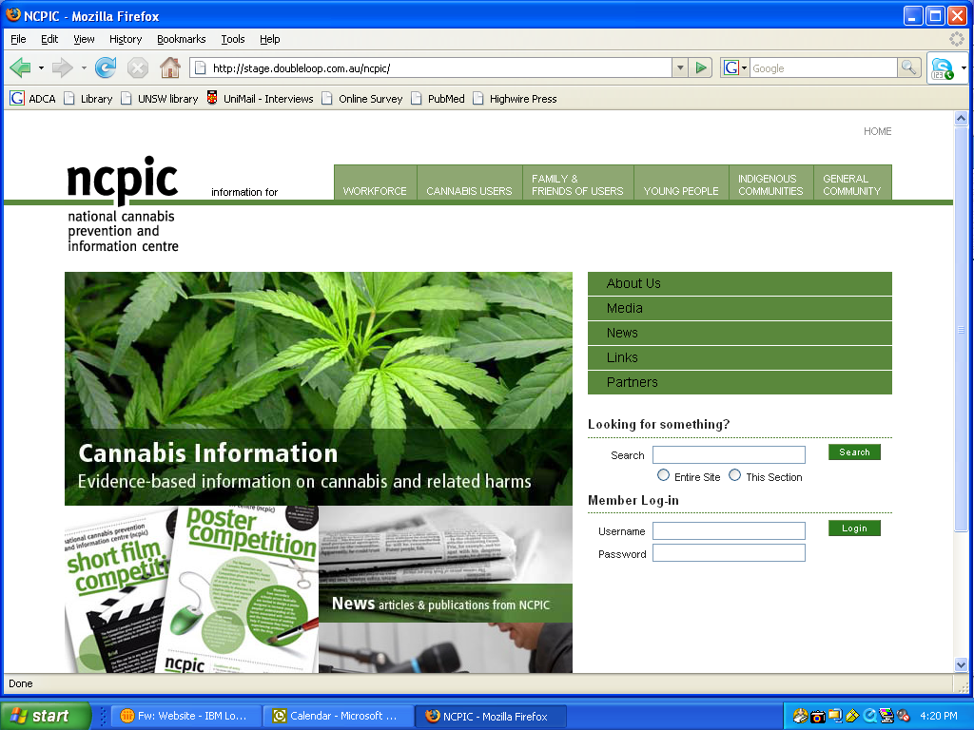
NCPIC website www. ncpic.org.au
Cannabis Information and Helpline 1800 30 40 50

Slide 55
Pharmacological interventions
There are no randomised control trials (RCTs) of pharmacological interventions for cannabis withdrawal or craving.
The results of less methodologically rigorous studies suggest that oral THC,9,10 and possibly mirtazapine11 and lithium ¹², are promising for cannabis withdrawal, and that rimonobant¹³ and perhaps buspiron¹⁴ show potential in the management of cannabis craving.
Buproprion,¹⁵ nefazodone,¹⁶ divalproex ,^{11,17} naltrexone ¹⁸ and atomoxetine ¹⁹ appear less promising for cannabis withdrawal or craving.
Also, early indications suggest that oral THC is ineffective in the management of cannabis craving. ⁹
http://ncpic.org.au/ncpic/publications/research-briefs/article/evidence-based-interventions-for-cannabis-use-disorder

Slide 56
Psychological interventions
RCTs of psychotherapeutic approaches to managing cannabis dependence suggest:
  Cognitive behavioural therapy (CBT) and motivational enhancement therapy (MET) are the most effective in reducing cannabis use, dependence and related problems.²⁰⁻²²
  one study showed social support psychotherapy equivalent to CBT.²³
  Although brief interventions (usually MET) appear effective, recent studies suggest that extended, combined therapies are associated with slightly better outcomes.^{21,22}
  In addition, recent research suggests that adding voucher based incentives to MET and CBT improves treatment compliance and long term outcome in both voluntary²⁴⁻²⁶ and coerced adult clients²⁷⁻²⁹
  voucher-based incentives alone show improvements in compliance and outcome that diminish over time.²⁵
http://ncpic.org.au/ncpic/publications/research-briefs/article/evidence-based-interventions-for-cannabis-use-disorder

Slide 57
Adolescent and psychiatric populations
Several RCTs suggest:
  Brief interventions—which may involve the provision of information (including to parents), motivational enhancement therapy (MET), and cognitive behavioural skills training—are effective in reducing cannabis use and dependence in adolescents.^{30,31}
  It appears extended therapies, which often incorporate significant family involvement (such as multidimensional family therapy) are effective in reducing cannabis use and dependence in adolescents but no more so than are brief interventions.³²
  Contingency management also shows promise in enhancing treatment engagement in adolescents.³³
http://ncpic.org.au/ncpic/publications/research-briefs/article/evidence-based-interventions-for-cannabis-use-disorder

Slide 58
Psychiatric populations
Clinicians’ recommendations for the management of substance use in the context of severe and persistent mental illness rests with integrated shared care or dual diagnosis services, in which the critical components are:
staffed interventions
assertive outreach
motivational interventions
Counselling
social support interventions
a comprehensive and long-term perspective
and cultural sensitivity and competence.^{35,36}
http://ncpic.org.au/ncpic/publications/research-briefs/article/evidence-based-interventions-for-cannabis-use-disorder

Slide 59
Evidence based interventions – key messages
Pharmacological interventions
    no RCTs of pharmacological interventions for cannabis withdrawal or craving
Most effective psychological interventions
    cognitive behavioural therapy (CBT)
    motivational enhancement therapy (MET) ²⁰⁻²²
Strongest evidence in the management of cannabis dependence
    MET and CBT in adults
    brief interventions in adolescents
http://ncpic.org.au/ncpic/publications/research-briefs/article/evidence-based-interventions-for-cannabis-use-disorder
Notes:
Evidence-based interventions for cannabis use disorder
Introduction
Despite cannabis being the most widely used illicit drug in the Western world,^{1,2} controlled trials for cannabis use disorder have been reported in the literature only in the last 15 years. Although many clinicians continue to conclude that the relatively mild withdrawal syndrome associated with cannabis indicates that dependence is unlikely and treatment is unnecessary, research suggests that a substantial proportion of cannabis users develop cannabis-related problems, including abuse and dependence.^{2,3-6} Despite these trends, only a minority seek assistance from a health professional,⁷ however, demand for treatment for cannabis use disorder is increasing internationally.⁸
Pharmacological interventions
There are no randomised control trials (RCTs) of pharmacological interventions for cannabis withdrawal or craving. The results of less methodologically rigorous studies suggest that oral delta 9-tetrahydrocannabinol (THC),^{9,10} and possibly mirtazapine¹¹ and lithium,¹² are promising for cannabis withdrawal, and that rimonobant¹³ and perhaps buspiron¹⁴ show potential in the management of cannabis craving. Buproprion,¹⁵ nefazodone,¹⁶ divalproex,^{11,17} naltrexone¹⁸ and atomoxetine¹⁹ appear less promising for cannabis withdrawal or craving. Also, early indications suggest that oral THC is ineffective in the management of cannabis craving.⁹
Psychological interventions
A series of RCTs of psychotherapeutic approaches to managing cannabis dependence have been conducted. In general, these suggest that cognitive behavioural therapy (CBT) and motivational enhancement therapy (MET) are the most effective in reducing cannabis use, dependence and related problems.²⁰⁻²² Social support psychotherapy showed equivalence with CBT in one study.²³ Although brief interventions (usually in the form of MET) appear effective, recent studies suggest that extended, combined therapies are associated with slightly better outcomes.^{21,22} In addition, recent research suggests that adding voucher-based incentives to MET and CBT improves treatment compliance and long-term outcome in both voluntary²⁴⁻²⁶ and coerced adult clients,²⁷⁻²⁹ but that voucher-based incentives alone show improvements in compliance and outcome that diminish over time.²⁵
Adolescent and psychiatric populations
Several RCTs suggest that brief interventions—which may involve the provision of information (including to parents), MET, and cognitive behavioural skills training—are effective in reducing cannabis use and dependence in adolescents.^{30,31} It also appears that extended therapies, which often incorporate significant family involvement (such as multidimensional family therapy), are effective in reducing cannabis use and dependence in adolescents, but no more so than are brief interventions.³² Contingency management also shows promise in enhancing treatment engagement in adolescents.³³
There is one RCT examining effective treatments for comorbid cannabis use and psychotic disorders, which compared ‘treatment as usual’ to ten sessions of motivational interviewing and cognitive behavioural therapy.³⁴ Clinicians’ recommendations for the management of substance use in the context of severe and persistent mental illness rests with integrated shared care or dual diagnosis services, in which the critical components are staffed interventions, assertive outreach, motivational interventions, counselling, social support interventions, a comprehensive and long-term perspective, and cultural sensitivity and competence.^{35,36}
Conclusion
Although the strongest evidence in the management of cannabis dependence exists for MET and CBT in adults and brief interventions in adolescents, further RCTs are required to clarify the effectiveness of other treatments, particularly pharmacological interventions and those designed for psychiatrically comorbid cannabis users.
References
Anthony, J., Warner, L. & Kessler, R. (1994). Comparative epidemiology of dependence on tobacco, alcohol, controlled substance and inhalants: Basic findings from the National Comorbidity Survey. Experimental and Clinical Psychopharmacology 2, 244-268.
Swift, W., Hall, W. & Teesson, M. (2001). Cannabis use and dependence among Australian adults: Results from the National Survey of Mental Health and Wellbeing. Addiction 96, 737-748.
Anthony, J.C. & Helzer, J.E. (1991). Syndromes of drug abuse and dependence. In. L.N. Robins & D.A. Regier. (Eds.). Psychiatric disorders in America: The Epidemiological Catchment Area Study, pp. 116-154. New York: The Free Press.
Bierut, L.J., Dinwiddie, S.H., Begleiter, H., Crowe, R.R., Hesselbrock, V., Nurnberger, J.I. Jr., Porjesz, B., Schuckit, M.A., & Reich, T. (1998). Familial transmission of substance dependence: Alcohol, marijuana, cocaine, and habitual smoking: A report from the Collaborative Study on the Genetics of Alcoholism. Archives of General Psychiatry 55, 982-988.
Grant, B.F. & Pickering, R. (1998). The relationship between cannabis use and DSM-IV cannabis abuse and dependence: Results from the National Longitudinal Alcohol Epidemiologic Survey. Journal of Substance Abuse 10, 255-264.
Young, S.E., Corley, R.P., Stallings, M.C., Rhee, S.H., Crowley, T.J., & Hewitt, J.K. (2002). Substance use, abuse and dependence in adolescence: Prevalence, symptom profiles and correlates. Drug and Alcohol Dependence 68, 309-322.
Copeland, J., Rees, V. & Swift, W. (1999). Health concerns and help-seeking among a sample entering treatment for cannabis dependence. Australian Family Physician 28, 540-541.
Substance Abuse and Mental Health Services Administration, Office of Applied Studies. (2003). Emergency department trends from the drug abuse warning network, final estimates 1995–2002, DAWN Series: D-24, DHHS Publication No. (SMA) 03-3780. Rockville, MD: Substance Abuse and Mental Health Services Administration, Office of Applied Studies.
Hart, C., Haney, M., Ward, A., Fischman, M.W., & Foltin, R.W. (2002). Effects of oral THC maintenance on smoked marijuana self-administration. Drug and Alcohol Dependence 67, 301-399.
Haney, M., Hart, C., Vosburg, S., Nasser, J., Bennett, A., & Zubaran, C., et al. (2004). Marijuana withdrawal in humans: Effects of oral THC or divalproex. Neuropsychopharmacology 29, 158-170.
Frewen, A., Baillie, A. & Rea, F. (2007, June). The role of mirtazapine in cannabis withdrawal. Paper contributed to the College on Problems of Drug Dependence. Quebec, Canada. Retrieved on September 8, 2008, from http://www.cpdd.vcu.edu/Pages/Meetings/Meetings_PDFs/2007programbooknew.pdf
Shu-Sen, C., Bowen, R.C., Gu, G.B., Hannesson, D.K., Yu, P.H., & Zhang, X. (2001). Prevention of cannabinoid withdrawal syndrome by lithium: Involvement of oxytocinergic neuronal activity. Journal of Neuroscience 21, 9867-9876.
Heustis, M.A., Gorelick, D.A., Heishman, S.J., Preston, K.L., Nelson, R.A., & Moolchan, E.T. (2001). Blockade effects of smoked marijuana by the CB1-selective cannabinoid receptor antagonist SR141716. Archives of General Psychiatry 58, 322-328.
McRae, A.L., Brady, K.T. & Carter, R.E. (2006). Buspirone for treatment of marijuana dependence: A pilot study. American Journal on Addictions 15, 404.
Haney, M., Ward, A.S., Comer, S.D., Hart, C.L., Foltin, R.W., & Fischman, M.W. (2001). Buproprion SR worsens mood during marijuana withdrawal in humans. Psychopharmacology 155, 171-179.
Haney, M., Hart, C., Ward, A., & Foltin, R.W. (2003). Nefazodone decreases anxiety during marijuana withdrawal in humans. Psychopharmacology 165, 157-165.
Levin, F.R., McDowell, D., Evans, S.M., Nunes, E., Akerele, E., & Donovan, S. et al. (2004). Pharmacotherapy for marijuana dependence: A double-blind, placebo-controlled pilot study of divalproex sodium. American Journal on Addictions 13, 21-32.
Haney, M., Bisaga, A. & Foltin, R.W. (2003). Interaction between naltrexone and oral THC in heavy marijuana smokers. Psychopharmacology 166, 77-85.
Tirado, C.F., Goldman, M., Kampman, K.M., & O’Brien, C.P. (2007, June). Atomoxetine for treatment of marijuana dependence: A report on the efficacy and high incidence of gastrointestinal adverse events in a pilot study. Paper contributed to the College on Problems of Drug Dependence. Quebec, Canada. Retrieved on September 8, 2008, from http://www.cpdd.vcu.edu/Pages/Meetings/Meetings_PDFs/2007programbooknew.pdf
Stephens, R., Roffman, R. & Curtin, L. (2000). Comparison of extended versus brief treatments for marijuana use. Journal of Consulting and Clinical Psychology 68, 898-908.
Copeland, J., Swift, W., Roffman, R., & Stephens, R. (2001). A randomised controlled trial of brief interventions for cannabis use disorder. Journal of Substance Abuse Treatment 21, 55-64.
Babor, T., Carroll, K., Christiansen, K., Donaldson, J., Herrell, J., & Kadden, R. et al. (2004). Brief treatments for cannabis dependence: Findings from a randomised multi-site trial. Journal of Consulting and Clinical Psychology 72, 455-466.
Stephens, R., Roffman, R. & Simpson, E. (1994). Treating adult marijuana dependence: A test of the relapse prevention model. Journal of Consulting and Clinical Psychology 62, 92-99.
Budney, A., Higgins, S., Radanovich, K., & Novy, P. (2000). Adding voucher-based incentives to coping skills and motivational enhancement improves outcomes during treatment for marijuana dependence. Journal of Consulting and Clinical Psychology 68, 1051-1061.
Budney, A.J., Moore, B.A., Rocha, H.L., & Higgins, S.T. (2006). Clinical trial of abstinence-based vouchers and cognitive behavioral therapy for cannabis dependence. Journal of Consulting and Clinical Psychology 74, 307-316.
Kadden, R.M., Litt, M.D., Kabela-Cormier, E., & Petry, N.M. (2007). Abstinence rates following behavioral treatments for marijuana dependence. Addictive Behaviours 32, 1220-1236.
Stephens, R.S., Roffman, R.A., Fearer, S.A., Williams, C., & Burke, R.S. (2007). The marijuana check-up: Promoting change in ambivalent marijuana users. Addiction 102, 947-957.
Sinha, R., Easton, C. & Kemp, K. (2003). Substance abuse treatment characteristics of probation-referred young adults in a community-based outpatient program. American Journal of Drug and Alcohol Abuse 29, 585-597.
Carroll, K.M., Easton, C.J., Nich, C., Hunkele, K.A., Neavins, T.M., & Sinha, R. et al. (2006). The use of contingency management and motivational/skills-building therapy to treat young adults with marijuana dependence. Journal of Consulting and Clinical Psychology 74, 955-966.
Martin, G. & Copeland, J. (2008). The adolescent cannabis check-up: Randomised trial of a brief intervention for young cannabis users. Journal of Substance Abuse Treatment 34, 407-414.
Walker, D.D., Roffman, R.A., Stephens, R.S., Wakana, K., Berghuis, J., & Kim, W. (2006). Motivational enhancement therapy for adolescent marijuana users: A preliminary randomised trial. Journal of Consulting and Clinical Psychology 74, 628-632.
Dennis, M., Godley, S.H., Diamond, G., Tims, F.M., Babor, T., & Donaldson, J. et al. (2004). The Cannabis Youth Treatment (CYT) study: Main findings from two randomised trials. Journal of Substance Abuse Treatment 27, 197-213.
Sinha, R., Easton, C., Renee-Aubin, L., & Carroll, K. (2003). Engaging young probation-referred marijuana abusing individuals in treatment: A pilot trial. American Journal on Addictions 12, 314-323.
Baker, A., Bucci, S., Lewin, T.J., Kay-Lambkin, F., Constable, P.M., & Carr, V.J. (2006). Cognitive-behavioural therapy for substance use disorders in people with psychotic disorders. British Journal of Psychiatry 188, 439-448.
Drake, R., Essock, S. & Shaner, A. (2001). Implementing dual diagnosis services for clients with severe mental illness. Psychiatric Services 52, 469-476.
Carey, K., Purnine, D., Maisto, S., Carey, M.P., & Simons, J.S. (2000). Treating substance abuse in the context of severe and persistent mental illness clinician’s perspectives. Journal of Substance Abuse Treatment 19, 189-198.

Slide 60
“Cannabis competency”

Slide 61
“Cannabis Competency”
Historically the CHC qualifications have not specified drugs by name (other than alcohol and tobacco).
This has lead to a lack of clarity about which drugs should be taught and assessed.
Exacerbated by limited student interest and student self direction.
Feedback from industry (Pidd et al, 2010) indicates that many students entering the workforce do not know enough about specific drugs and their treatment.
It is critical that students leave training are able to work with client cannabis issues competently.

Slide 62
What constitutes ‘cannabis competence’?
CANNABIS ISSUES FOR THE SPECIALIST AOD NURSE
The specialist nurse in the ATOD field requires evidence-based guidelines, tools and intervention strategies to facilitate effective screening, assessment and interventions for clients experiencing cannabis-related problems, including dependence, withdrawal, co-morbidity with mental health disorders, and polydrug use.
        Submission to the National Cannabis Strategy Drug and Alcohol Nurses of Australasia (DANA) 2005

Slide 63
Cannabis competency
CANNABIS ISSUES FOR THE SPECIALIST AOD NURSE
While further research is still needed to better enable nurses to provide effective and evidence-based interventions for those affected by their use of cannabis, specialist nurses also need to acquire advanced competencies to assist them to apply specific skills, knowledge and abilities to deliver such interventions.
        Submission to the National Cannabis Strategy Drug and Alcohol Nurses of Australasia (DANA) 2005

Slide 64
Cannabis competencies
CANNABIS ISSUES FOR THE SPECIALIST AOD NURSE
require the organisational policies, protocols and support to deliver interventions in a way that improves client outcomes through ensuring that individuals (including those from high risk groups such as young people, pregnant women and Indigenous Australians) can readily access relevant information and treatment.
        Submission to the National Cannabis Strategy Drug and Alcohol Nurses of Australasia (DANA) 2005

Slide 65
Discussion
Specialist nurses are one group of AOD workers. What would you identify are cannabis competencies for a range of other workers:
  AOD workers
  Social workers
  Doctors
  Peer workers
  Needle and syringe program workers
  Prevention workers
  Addiction medicine specialists and specialist
  Psychologists and psychiatrists.

Slide 66
Assessing cannabis competency

Slide 67
Assessment Activity
Review an element of competency in the Framework
Considering the activities described and those in the underpinning skills and knowledge discuss whether it meets the requirements for assessment.
Do they meet the requirements for:
    validity
    reliability
    flexibility
    fairness
    sufficiency
Notes:
Validity – does it test what it is supposed to test
Reliability – will it work if you do it again
Flexibility – does it take into account different assessment situations, student variability, delivery variability
Fairness – is it testing all students for the same thing
Sufficiency – is there enough evidence to assure competence

Slide 68
RPL strategies

Slide 69
RPL issues in AOD
Like most sectors AOD has issues with RPL
Number of students RPLed is low
Concerns about the quality of RPL
  Most providers developed their own system
  Subject to highly variable interpretation and application
  No common system
Most students not assessed on cannabis
  (Trainers Talking Training)

Slide 70
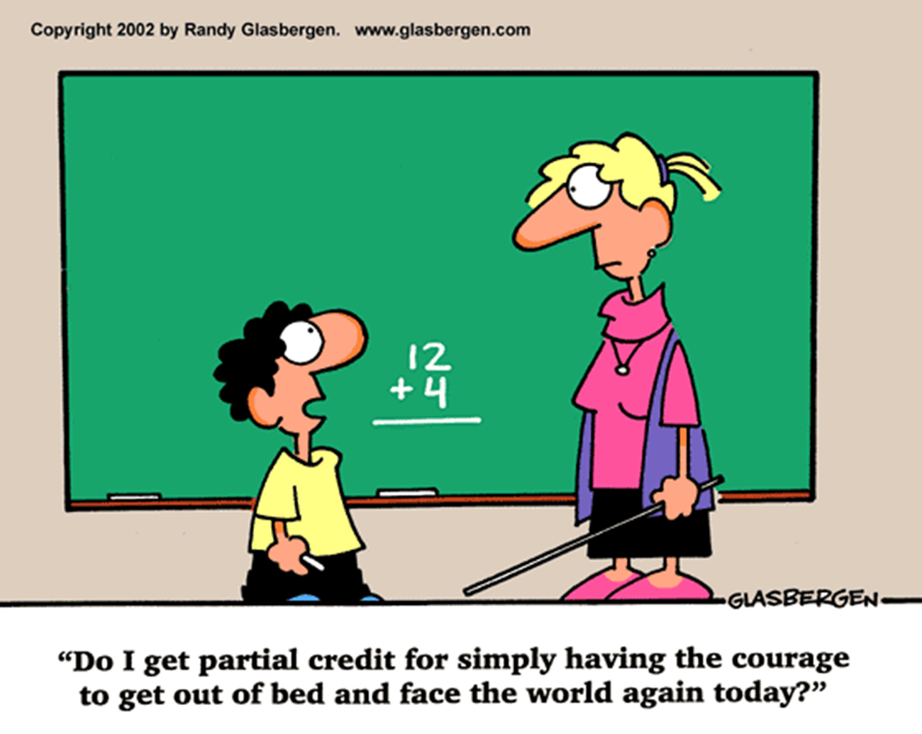

Slide 71
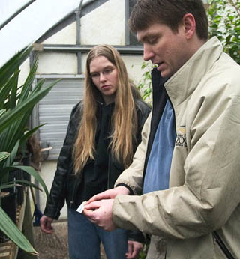
RPL Skills
We use these skills in teaching
  The guide on the side
  Learner centred practice
  Collaborative teams
  Experiential learning
  Mentoring
  Industry partnerships
We use these skills in industry
  Client centered practice
  Customer focus
  Action learning
  Behavioural Interviewing
  Mentoring
  360 degree feedback
  Appreciative inquiry

Slide 72
Six Steps to Recognition (CSHITB)
Supported process
Paper work minimised
Interview and observation driven
Empowering
Generates evidence
Developmental & validation pathways
Notes:
Michael

Slide 73
Key step
  Organisation and candidate receive briefing on process and requirements
Candidate receives kit:
  RPL Brochure
  Nomination form
  Self assessment form
  3rd Party assessment
  Competency list
  Process overview
  Contact numbers
Notes:
Michael

Slide 74
Develop partnership with candidate
Review congruence of preliminary evidence
Benchmark candidates’ responses
Explore depth of skill
Plan assessment pathway
Notes:
Michael

Slide 75
Generating Evidence
  Employer nomination
  Candidate's CV
  Evidence of relevant qualifications
  Job description
  3rd party assessment
  Self-assessment of Competency
  Assessors record of discussion of critical aspects of assessment
Notes:
Michael

Slide 76
On site visit
Assessor observes and questions
  makes checks of the evidence against the competency units
    elements, performance criteria
    essential knowledge and underpinning skills.
Secondary sources focus
  Gathering relevant workplace evidence
  Documents and photographs (where appropriate)
Notes:
Michael

Slide 77
Focus moves to explore essential knowledge
Make recommendation
Prepare the candidate for the digital video recording, if required
Notes:
Michael

Slide 78
Audit requirements focus
Demonstrate essential knowledge, skills and attitudes
Assessor completes documentation in line with AQTF
Evaluation (what worked, what would you change)
Notes:
Michael

Slide 79
Electronic portfolio
Section Nine - Assessment Matrix - Unit of Competency and evidence collection table
BSB 51107 Diploma of Management Student: Michael White
Unit 1: BSBWOR501A Manage Personal Work Priorities and Professional Development
 | Elements of Competency | Performance Criteria | Screenings | Student Comments | Evidence provided | Assessors comments | Signed & dated:
1.1 | Establish personal work goals | 1.1 Serve as a positive role model in the workplace through personal work planning and organisation 1.2 Ensure personal work goals, plans and activities reflect the organisation’s plans, and own responsibilities and accountabilities 1.3 Measure and maintain personal performance in varying work conditions, work contexts and contingencies |  | work plan as used in previous job CV Position description developed for Training Team Stress Man Training program I delivered Personal reference Team work plans developed at CECFW CSHITB Operational Plan | Business plan MW CV MWhite 2008 FLM RPL 2008 resources\position descriptions FLM RPL 2008 resources\Stress Management.pdf Personal reference.pdf team work plans CECFW FLM RPL 2008 resources\Final OPPlan with $08-09.doc
Notes:
Michael

Slide 80
Moderation and continuous improvement
Notes:
Michael

Slide 81
Moderation
Moderation refers to a process of comparing assessment judgments in relation to the same learning outcomes of different assessors in a variety of different contexts.
The purpose of moderation is to ensure comparability of assessment.
Actively addresses important issue of consistency of interpretation and implementation of competency standards (both content and assessment) in VET.
Notes:
Moderation of Assessments in Vocational Education and Training
G. S. Maxwell, University of Queensland
Department of Employment and Training, Queensland. January 2001

Slide 82
Discussion
What is your current process for moderating materials/assessments?
Do you undertake internal and/or external moderation?
What would help with external moderation?
What strategies have you implemented in relation to ongoing improvement of you content and assessments?
Notes:
Discuss online community

Slide 83
Review, questions and feedback

Slide 84
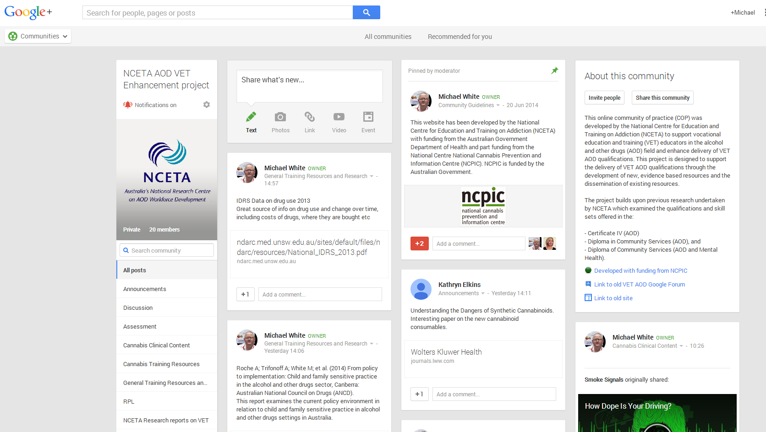
Google Group for Trainers
https://plus.google.com/u/0/communities/109081727783576106446

Slide 85
Thank you

Slide 86
Key References
Anthony, J., Warner, L. & Kessler, R. (1994). Comparative epidemiology of dependence on tobacco, alcohol, controlled substance and inhalants: Basic findings from the National Comorbidity Survey. Experimental and Clinical Psychopharmacology 2, 244-268.
Swift, W., Hall, W. & Teesson, M. (2001). Cannabis use and dependence among Australian adults: Results from the National Survey of Mental Health and Wellbeing. Addiction 96, 737-748.
Anthony, J.C. & Helzer, J.E. (1991). Syndromes of drug abuse and dependence. In. L.N. Robins & D.A. Regier. (Eds.). Psychiatric disorders in America: The Epidemiological Catchment Area Study, pp. 116-154. New York: The Free Press.
Bierut, L.J., Dinwiddie, S.H., Begleiter, H., Crowe, R.R., Hesselbrock, V., Nurnberger, J.I. Jr., Porjesz, B., Schuckit, M.A., & Reich, T. (1998). Familial transmission of substance dependence: Alcohol, marijuana, cocaine, and habitual smoking: A report from the Collaborative Study on the Genetics of Alcoholism. Archives of General Psychiatry 55, 982-988.
Grant, B.F. & Pickering, R. (1998). The relationship between cannabis use and DSM-IV cannabis abuse and dependence: Results from the National Longitudinal Alcohol Epidemiologic Survey.Journal of Substance Abuse 10, 255-264.
Young, S.E., Corley, R.P., Stallings, M.C., Rhee, S.H., Crowley, T.J., & Hewitt, J.K. (2002). Substance use, abuse and dependence in adolescence: Prevalence, symptom profiles and correlates. Drug and Alcohol Dependence 68, 309-322.
Copeland, J., Rees, V. & Swift, W. (1999). Health concerns and help-seeking among a sample entering treatment for cannabis dependence. Australian Family Physician 28, 540-541.
Substance Abuse and Mental Health Services Administration, Office of Applied Studies.(2003). Emergency department trends from the drug abuse warning network, final estimates 1995–2002, DAWN Series: D24, DHHS Publication No. (SMA) 033780. Rockville, MD: Substance Abuse and Mental Health Services Administration, Office of Applied Studies.
Hart, C., Haney, M., Ward, A., Fischman, M.W., & Foltin, R.W. (2002). Effects of oral THC maintenance on smoked marijuana self-administration. Drug and Alcohol Dependence 67, 301-399.
Haney, M., Hart, C., Vosburg, S., Nasser, J., Bennett, A., & Zubaran, C., et al. (2004). Marijuana withdrawal in humans: Effects of oral THC or divalproex. Neuropsychopharmacology 29, 158-170.

Slide 87
References
Frewen, A., Baillie, A. & Rea, F. (2007, June). The role of mirtazapine in cannabis withdrawal. Paper contributed to the College on Problems of Drug Dependence. Quebec, Canada. Retrieved on September 8, 2008, from http://www.cpdd.vcu.edu/Pages/Meetings/Meetings_PDFs/2007programbooknew.pdf
Shu-Sen, C., Bowen, R.C., Gu, G.B., Hannesson, D.K., Yu, P.H., & Zhang, X. (2001). Prevention of cannabinoid withdrawal syndrome by lithium: Involvement of oxytocinergic neuronal activity. Journal of Neuroscience 21, 9867-9876.
Heustis, M.A., Gorelick, D.A., Heishman, S.J., Preston, K.L., Nelson, R.A., & Moolchan, E.T.(2001). Blockade effects of smoked marijuana by the CB1-selective cannabinoid receptor antagonist SR141716. Archives of General Psychiatry 58, 322-328.
McRae, A.L., Brady, K.T. & Carter, R.E. (2006). Buspirone for treatment of marijuana dependence: A pilot study. American Journal on Addictions 15, 404.
Haney, M., Ward, A.S., Comer, S.D., Hart, C.L., Foltin, R.W., & Fischman, M.W. (2001). Buproprion SR worsens mood during marijuana withdrawal in humans. Psychopharmacology 155, 171-179.
Haney, M., Hart, C., Ward, A., & Foltin, R.W. (2003). Nefazodone decreases anxiety during marijuana withdrawal in humans. Psychopharmacology 165, 157-165.
Levin, F.R., McDowell, D., Evans, S.M., Nunes, E., Akerele, E., & Donovan, S. et al. (2004). Pharmacotherapy for marijuana dependence: A doubleblind, placebocontrolled pilot study of divalproex sodium. American Journal on Addictions 13, 21-32.
Haney, M., Bisaga, A. & Foltin, R.W. (2003). Interaction between naltrexone and oral THC in heavy marijuana smokers. Psychopharmacology 166, 77-85.
Tirado, C.F., Goldman, M., Kampman, K.M., & O’Brien, C.P. (2007, June). Atomoxetine for treatment of marijuana dependence: A report on the efficacy and high incidence of gastrointestinal adverse events in a pilot study. Paper contributed to the College on Problems of Drug Dependence. Quebec, Canada. Retrieved on September 8, 2008, from http://www.cpdd.vcu.edu/Pages/Meetings/Meetings_PDFs/2007programbooknew.pdf
Stephens, R., Roffman, R. & Curtin, L. (2000). Comparison of extended versus brief treatments for marijuana use. Journal of Consulting and Clinical Psychology 68, 898-908.
Copeland, J., Swift, W., Roffman, R., & Stephens, R. (2001). A randomised controlled trial of brief interventions for cannabis use disorder. Journal of Substance Abuse Treatment 21, 55-64.
Babor, T., Carroll, K., Christiansen, K., Donaldson, J., Herrell, J., & Kadden, R. et al.(2004). Brief treatments for cannabis dependence: Findings from a randomised multi-site trial.Journal of Consulting and Clinical Psychology 72, 455-466.
Stephens, R., Roffman, R. & Simpson, E. (1994). Treating adult marijuana dependence: A test of the relapse prevention model. Journal of Consulting and Clinical Psychology 62, 92-99.

Slide 88
Budney, A., Higgins, S., Radanovich, K., & Novy, P. (2000). Adding voucher-based incentives to coping skills and motivational enhancement improves outcomes during treatment for marijuana dependence. Journal of Consulting and Clinical Psychology 68, 1051-1061.
Budney, A.J., Moore, B.A., Rocha, H.L., & Higgins, S.T. (2006). Clinical trial of abstinence-based vouchers and cognitive behavioral therapy for cannabis dependence. Journal of Consulting and Clinical Psychology 74, 307-316.
Kadden, R.M., Litt, M.D., Kabela-Cormier, E., & Petry, N.M. (2007). Abstinence rates following behavioral treatments for marijuana dependence. Addictive Behaviours 32, 1220-1236.
Stephens, R.S., Roffman, R.A., Fearer, S.A., Williams, C., & Burke, R.S. (2007). The marijuana check-up: Promoting change in ambivalent marijuana users. Addiction 102, 947-957.
Sinha, R., Easton, C. & Kemp, K. (2003). Substance abuse treatment characteristics of probationreferred young adults in a communitybased outpatient program. American Journal of Drug and Alcohol Abuse 29, 585-597.
Carroll, K.M., Easton, C.J., Nich, C., Hunkele, K.A., Neavins, T.M., & Sinha, R. et al. (2006). The use of contingency management and motivational/skills-building therapy to treat young adults with marijuana dependence. Journal of Consulting and Clinical Psychology 74, 955-966.
Martin, G. & Copeland, J. (2008). The adolescent cannabis check-up: Randomised trial of a brief intervention for young cannabis users. Journal of Substance Abuse Treatment 34, 407-414.
Walker, D.D., Roffman, R.A., Stephens, R.S., Wakana, K., Berghuis, J., & Kim, W. (2006). Motivational enhancement therapy for adolescent marijuana users: A preliminary randomised trial.Journal of Consulting and Clinical Psychology 74, 628-632.
Dennis, M., Godley, S.H., Diamond, G., Tims, F.M., Babor, T., & Donaldson, J. et al. (2004). The Cannabis Youth Treatment (CYT) study: Main findings from two randomised trials. Journal of Substance Abuse Treatment 27, 197-213.
Sinha, R., Easton, C., Renee-Aubin, L., & Carroll, K. (2003). Engaging young probation-referred marijuana abusing individuals in treatment: A pilot trial. American Journal on Addictions 12, 314-323.
Baker, A., Bucci, S., Lewin, T.J., Kay-Lambkin, F., Constable, P.M., & Carr, V.J. (2006). Cognitive-behavioural therapy for substance use disorders in people with psychotic disorders. British Journal of Psychiatry 188, 439-448.
Drake, R., Essock, S. & Shaner, A. (2001). Implementing dual diagnosis services for clients with severe mental illness. Psychiatric Services 52, 469-476.
Carey, K., Purnine, D., Maisto, S., Carey, M.P., & Simons, J.S. (2000). Treating substance abuse in the context of severe and persistent mental illness clinician’s perspectives. Journal of Substance Abuse Treatment 19, 189-198.
Illicit Drug Use among Older Adults. NSDUH Report, Substance Abuse and Mental Health Services Administration (SAMHSA), September 1, 2011, http://oas.samhsa.gov/2k11/013/WEB_SR_013_HTML.pdf
Australian Institute of Health and Welfare 2012. Alcohol and Other Drug Treatment Services National Minimum Data Set 2012–13: Specifications and collection manual. Drug Treatment Series number 17. Cat. no. HSE 123. Canberra: AIHW.

